Slide 1


DO NOW
Activate Prior Knowledge
What is the difference between a sample and population?
Reminder:
Phones away
Bags on floor
Books out
Pens out

Slide 2

What is the difference between the population and the sample of a study?
Activate Prior Knowledge
Sample:
In a study or experiment, the sample is the group that is a subset of the population (a larger group) being studied for research purposes
Population:
The group of *people to whom the findings from a research study apply

Slide 3
Do now
Match the correct term to the definition
Terminology | Definition
Operationalise | A variable that could impact the results in research and is controlled for
Extraneous variable | The extent to how replicable a piece of research is and how consistent the results would be
Reliability | If the research is testable, measurable, and follows a method
Validity | Taking an abstract variable and making it testable and measurable
Scientific | The variable measured in research
Dependent variable | The extent to which your research measures what it intends to measure (how accurate it is)
Reminders:
Phones away
Bags on floor
Books out
Pens out
Whiteboard
Reminders
Next assessment: due week 8 Investigation 1: Data manipulation

Slide 4
Answers
Terminology | Definition
Extraneous variable | A variable that could impact the results in research and is controlled for
Reliability | The extent to how replicable a piece of research is and how consistent the results would be
Scientific | If the research is testable, measurable, and follows a method
Operationalise | Taking an abstract variable and making it testable and measurable
Dependent variable | The variable measured in research
Validity | The extent to which your research measures what it intends to measure (how accurate it is)
Reminders:
Phones away
Bags on floor
Books out
Pens out
Reminders
Next assessment: due week 8 Investigation 1: Data manipulation

Slide 5
What do I need to prepare?
ASSESSMENT – Recap
What is it?
It is a Scientific piece of research. You will have to collect data, analyse it and write a report
You will need to prepare notes for each section of your poster.
You will write up your poster in test conditions:
Introduction, Method, Results, Discussion
When is it due?
Next Tuesday – write up
How much is it worth?
12.5%
Who here is near a grade boundary?
Who here wants to improve their grade?

Slide 6
Listen to the brief

Slide 7
Learning Intention
Your turn:
Complete your method and ethics section!
I will be able to write a method section for my investigation, including participants, materials, procedure.
I will continue to draft my introduction section

Slide 8
Success Criteria
I will participate in the investigation –
Experimental or control group
I will complete my notes for my method section
I will start the introduction and undertake a peer review

Slide 9
Write-up hints
Skill Development
Writing style
In this learning task you are the student, researcher and participant
You are writing your report in third person as the researcher
Do not write in first hand or as a student / participant
Use as much scientific terminology to describe the sampling, method, and results.
Literature review sentence starters
Davey (2019) noted that…
From the previous research it was found that __________
Previous research indicates that ________
Another study by _________ also found similar results that_______

Slide 10
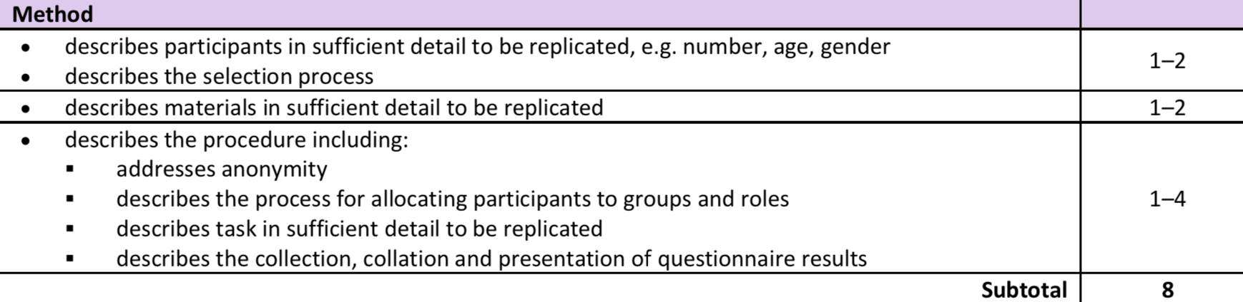
Method
Skill development
Step 1
Identify participants (how many? Who are they/demographic information)
Identify sampling method
Explain why sampling method was used
Identify participant allocation
Explain why participant allocation was used

Slide 11
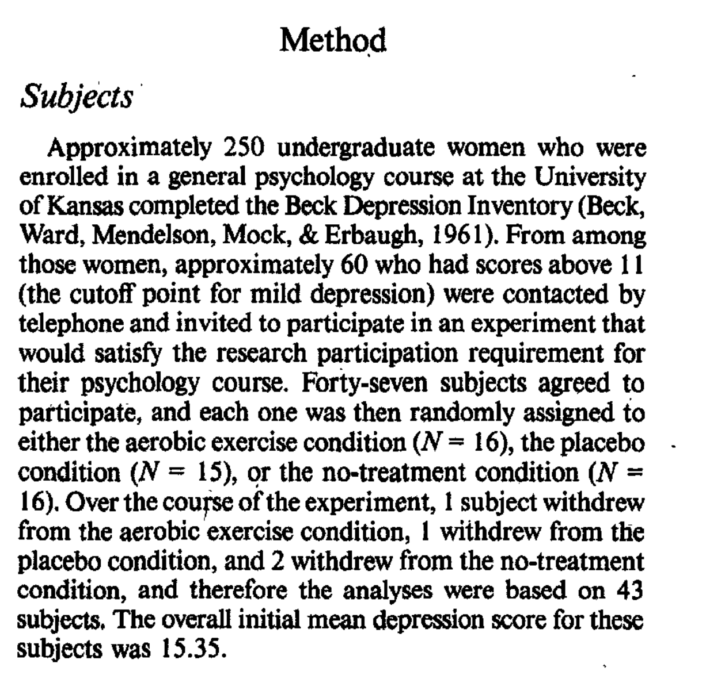

Method
Example of Step 1:
Skill development

Slide 12
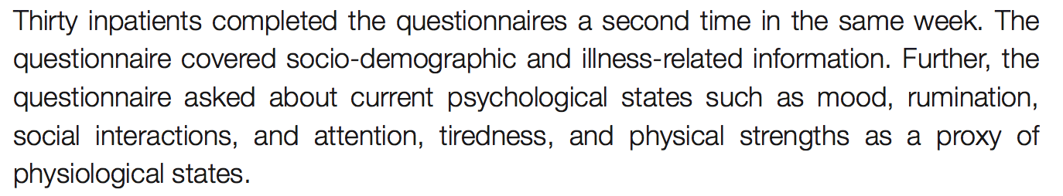
Method
Skill development
Step 2
Identify the materials used in the investigation
Explain why materials were used

Slide 13
Method
Skill development
Step 4
Provide a step-by-step guide on the procedure of the investigation
Sentence starters:
Firstly the researchers briefed participants on the aim that…..
Then the researchers handed out the questionnaire that measured…
Participants anonymity was maintained through…

Slide 14
Method
Skill development
Step 5
Identify possible extraneous variables.
Explain how extraneous variables are being controlled for.
Vocabulary
Extraneous variables: variables that the researchers tries to control for, so they do not influence the dependent variable (they are not being studied in the experiment).

Slide 15
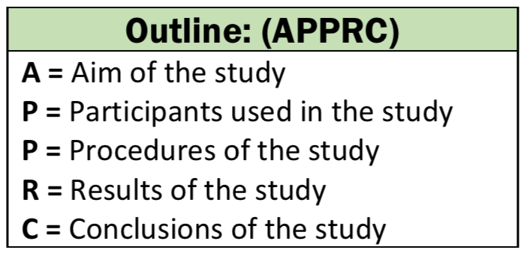
Literature review station activity
In pairs…
You will go around and summarise 4 research papers.
At each station:
One person will be scribe and take notes
One person will be be the reviewer
Switch roles at each station
Put the research into your own words and try to find a link to the current research.
This will be used in your introduction section.

Slide 16
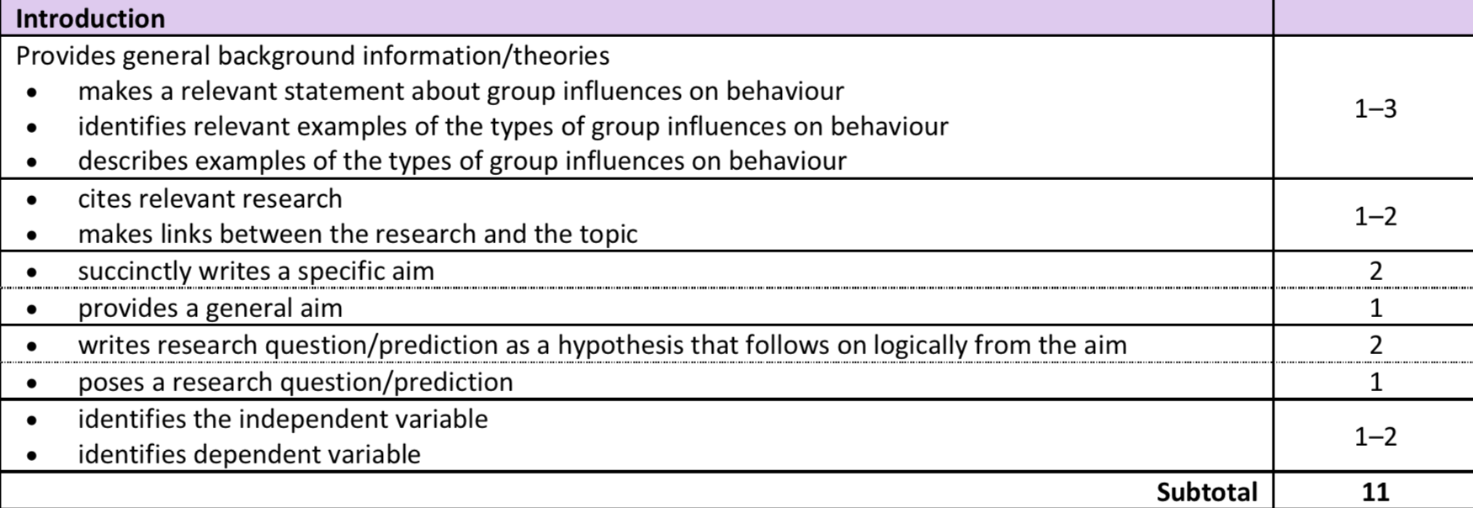
WHAT YOU NEED TO DO: Introduction
Skill development
A good introduction starts broad by introducing key concepts and terms (as if the person reading doesn’t have any prior knowledge) and gets more specific to the specific study taking place.
Use this as a guide for
When we come to drafting your
Introductions.
Writing your introduction is easier when you have read a few introductions on the same topic

Slide 17
Tips for an introduction
5 steps to Writing the Introduction
1) Establish Topic -- quick, concise (what is being studied). 2) Provide significance -- why it is generally important/interesting to study. 3) Review the relevant literature -- what the expert literature reveals (what the scientific community already know). Provides a summary, classification, comparison and evaluation of different studies. 4) Point out the gap -- what is the motivation for study = aim 5) Reveal the research question (hypothesis) – Identifies variables and formulates an operational hypothesis.
Skill development

Slide 18
WHAT YOU NEED TO DO: Introduction
Step 1: Establish the topic
What are you studying in this investigation?
State the topic in broad terms.
An example of establishing the topic from McCann and Holmes:
There is currently a substantial amount of interest in the use of strenuous aerobic exercise for reducing depression.
A good introduction starts broad by introducing key concepts and terms (as if the person reading doesn’t have any prior knowledge) and gets more specific to the specific study taking place.
Skill development

Slide 19
WHAT YOU NEED TO DO: Introduction
Step 2: Explain its significance
Describe relevant theories, models or concepts that demonstrate the relationship between exercise and mood
Summaries in your own words
Cite the sources of the theories using APA referencing (surname, year).
An example from McCann and Holmes:
The interest in the effects of exercise on depression appears to have been stimulated initially by the "feeling good" phenomenon associated with exercise (Cooper, 1968).
A good introduction starts broad by introducing key concepts and terms (as if the person reading doesn’t have any prior knowledge) and gets more specific to the specific study taking place.
Skill development

Slide 20
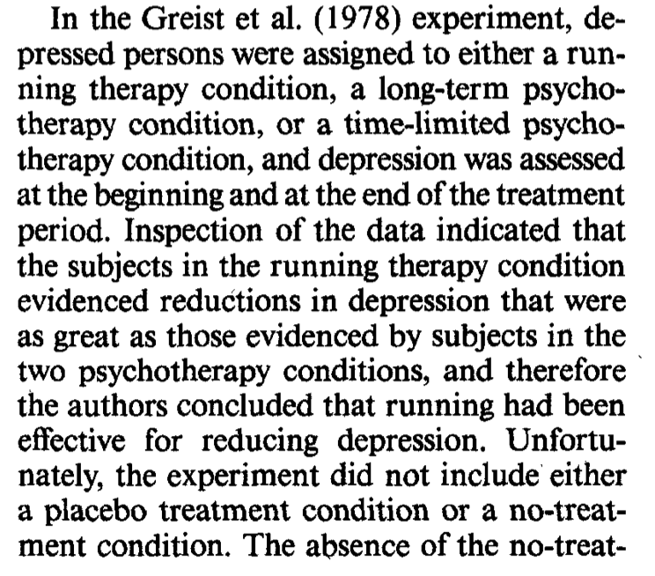
WHAT YOU NEED TO DO: Introduction
An example from McCann and Holmes
Step 3: Review relevant literature
Read McCann and Holmes and two more studies
Summaries at least two of studies’ method and findings
Evaluate the usefulness of each study to the current research = outline any weaknesses and strengths to contribute to why we are conducting the current study (link previous study to current study).
Cite the studies using APA referencing (surname, year).
Include other studies to help compare/add to understanding, without as much detail.
Skill development

Slide 21
WHAT YOU NEED TO DO: Introduction
Step 4: Point out the gap
Use a justification from previous studies (a gap in previous research).
Write the aim of the study.
An example from McCann and Holmes:
The present investigation was conducted to provide a controlled experimental test of the hypothesized relationship between strenuous aerobic exercise and decreases in depression.
A good introduction starts broad by introducing key concepts and terms (as if the person reading doesn’t have any prior knowledge) and gets more specific to the specific study taking place.
Skill development

Slide 22
ASSESSMENT 2 – Peer Review
Look at the rubric below
In groups of 2-3, switch drafts
Assess your peer’s work according to the rubric (5 minutes)
What do you notice was done well?
Is there anything they are missing or could be improved?
Give them constructive feedback! (2 minutes)
Make your improvements!

Slide 23
Learning Intention
I will be able to write a method section for my investigation, including participants, materials, procedure.
Success Criteria
Your turn:
Complete your method and ethics section!
I will complete my method section
outlined past research on leadership
Started my introduction

Slide 24
Success Criteria
I will participate in the station activity to practice outlining research
I will complete my introduction and undertake a peer review

